Slide 1
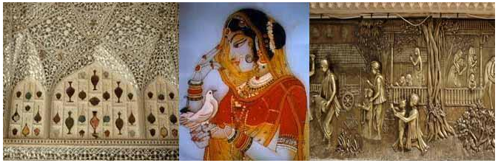
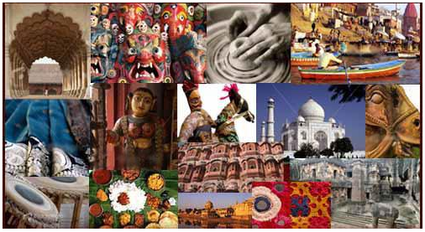
Current Developments in Arts and Culturals
KNC 602

Slide 2
Team Members
AMAN RAJ SINGH
ANTRIKSH TYAGI
HARDIK SONI
PUSHKAR SARASWAT
SAURABH PUNDIR

Slide 3
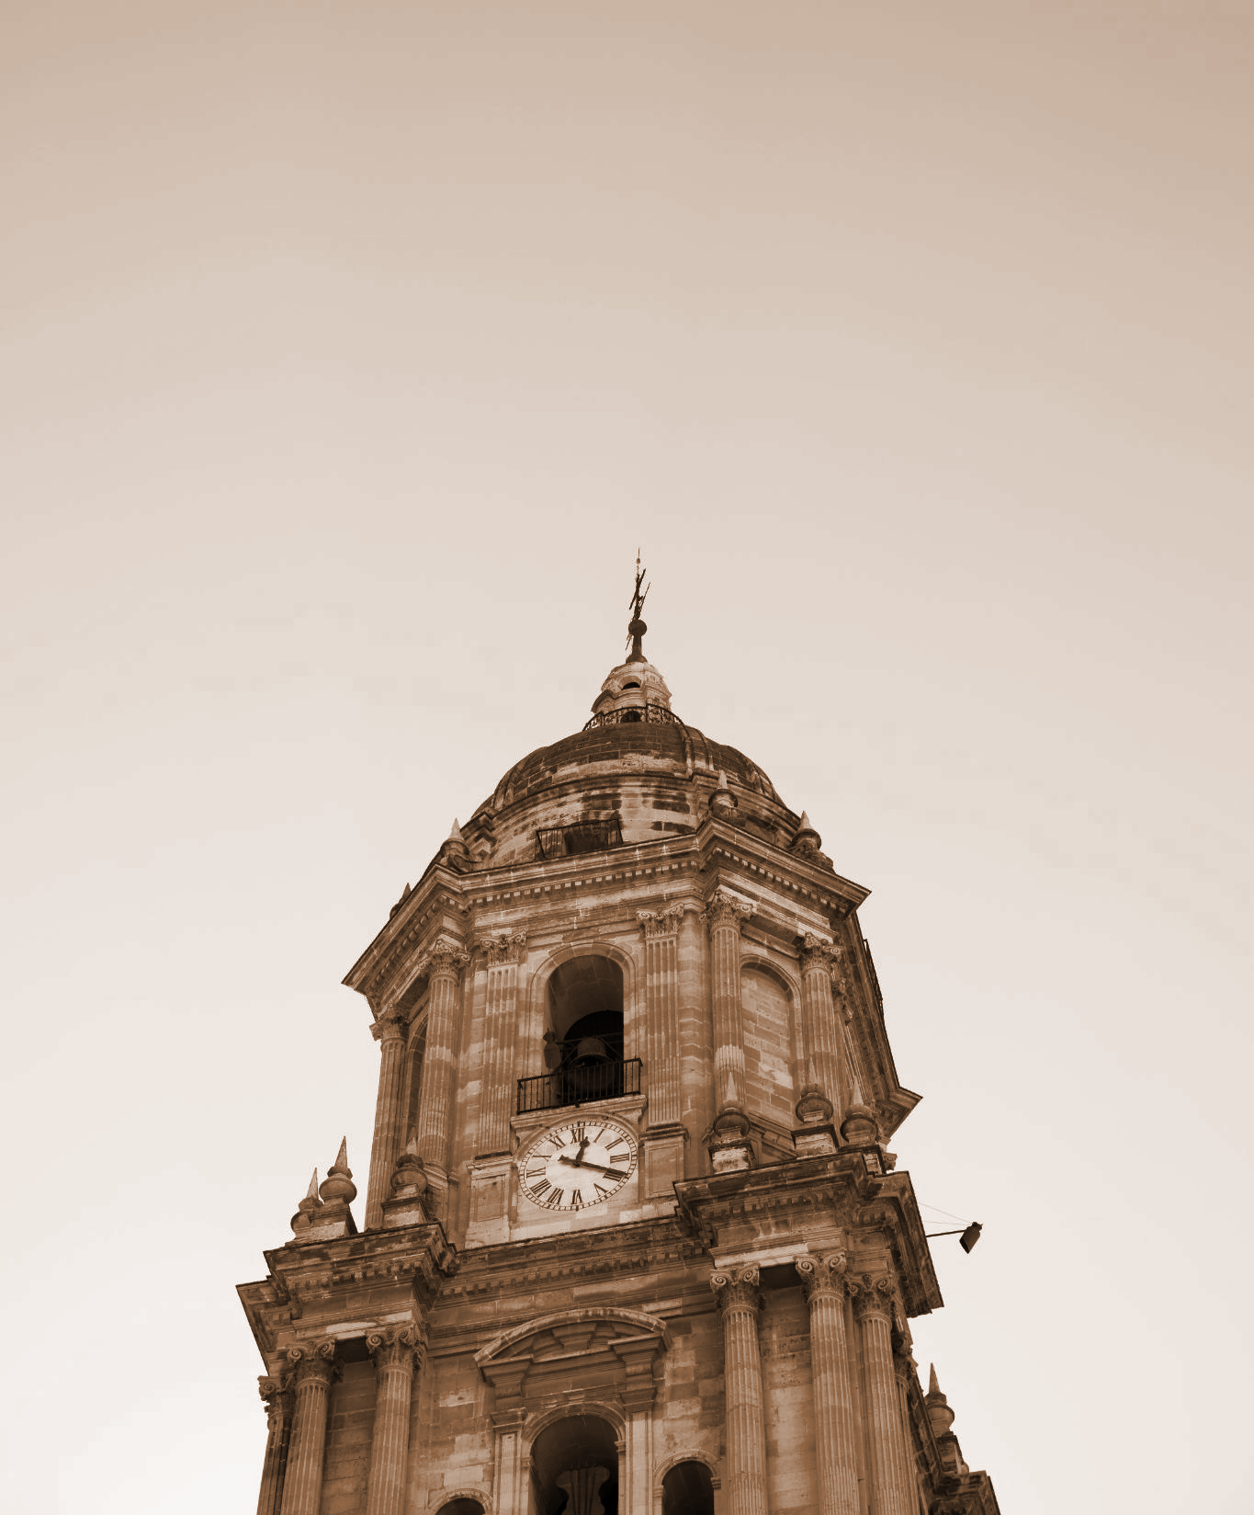
Index
* Arts & Culture
* Painting forms
* Dance forms
* Theater forms
* Music
* Architectural Heritage
* Literature
* Religions & festivals

Slide 4
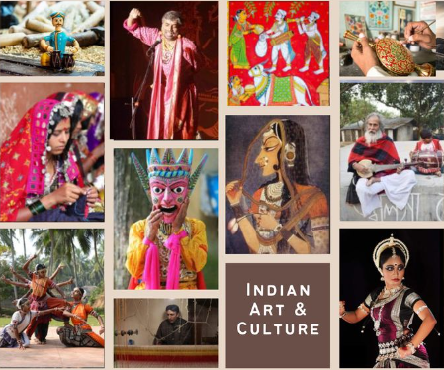
Arts & Culture
Long history, unique geography, various demographics, and a combination of customs have shaped the culture of India.
Even though the modern means have been established but still there
are values and beliefs which are still energetic in India.
Indian culture takes due care of the guests and serves them as God.
We believe and are taught “Atithi Devo Bhava”.
Indian art is filled with traditional history and devotional in nature.
Art is one aspect of culture.
Art is creative expression of one’s experiences, emotions and other qualities.
Its rareness is that it centres on Indian history, art, and religion.

Slide 5
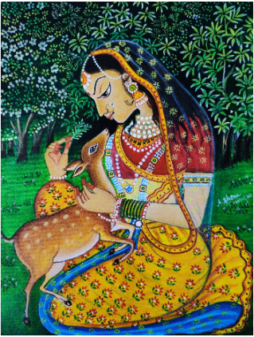
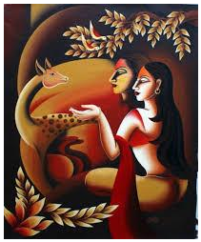
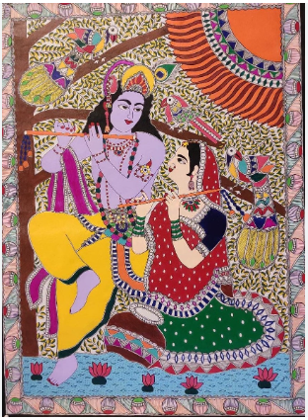
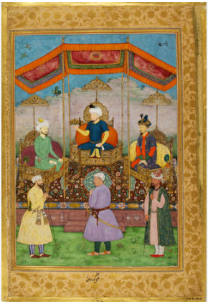
Painting Forms
Painting are basically two types:
Murals : large scale paintings generally attached to the floor of palaces and caves.
Miniatures : small scale which are done on mainly
cloth or paper.
Can be categorized into some special groups:
Rajasthani painting
Madhubani painting
Tanjore painting
Mughal painting
Bengal style of art
Patta chitra
Warli art

Slide 6
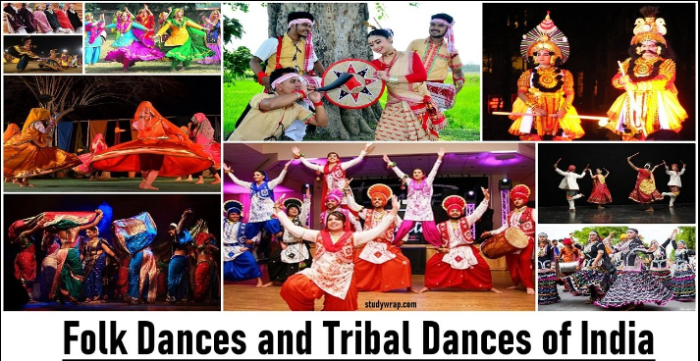
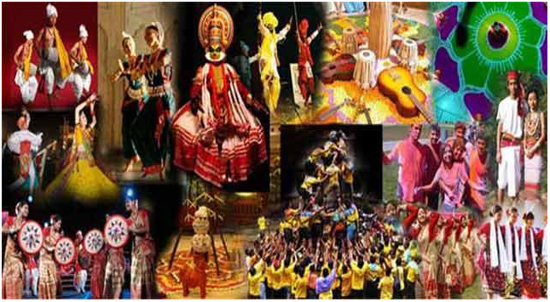
Dance Forms
Dance is a form of art, where the body is used as a medium of communication. The dance heritage of India is at least 5000 years old.
Classical Dance
Bharatnatyam – Tamil Nadu
Kathak – Uttar Pradesh
Kuchipudi – Andhra Pradesh
Folk Dance
Chhau – West Bengal
Ghoomer – Rajasthan
Bhangra – Punjab
Tribal Dance
Kaadar Nritham – Kochi area
Paniyar Kali – Wayand district

Slide 7
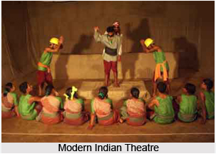
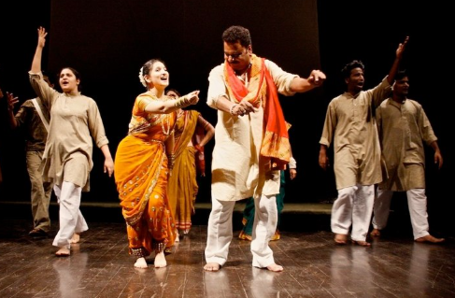
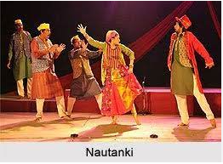
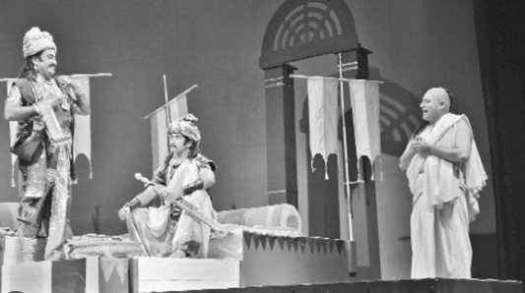
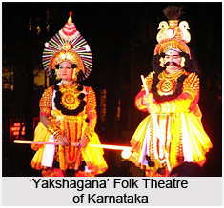
Theater Forms
Indian theater are divided into distinctive kinds:
Classical Theater
Sanskrit Theater
Traditional or Folk Theater
Modern Theater
It is also the home to the biggest film industry
of the world and films has been an integral part of our Indian culture. Films began to be exhibited in India in early1896 when an agent from Paris brought a movie exhibiting equipment to India and began showing movies.

Slide 8
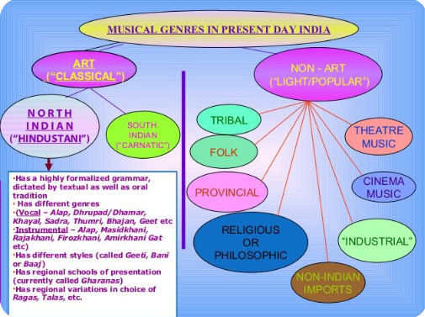
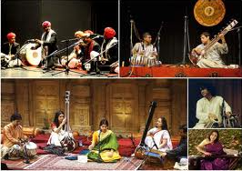
Classical Music in India
Hindustani (North Indian) Music
Rajasthani
Ganasangeet
Uttarakhandi folk music
Lavani
Carnatic (South Indian) Music

Slide 9
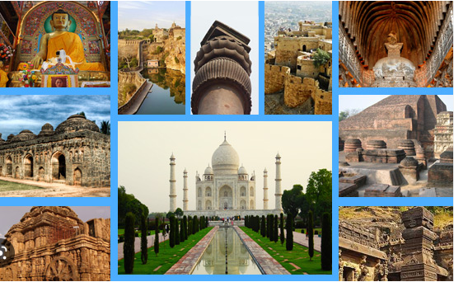
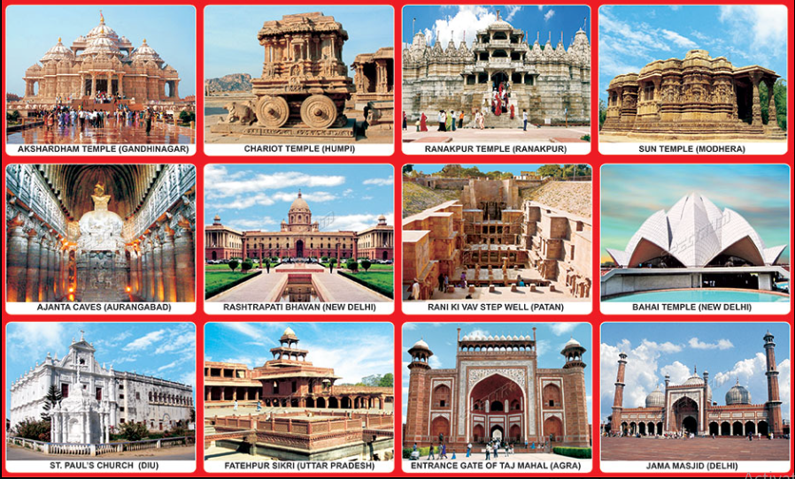
Architectural Heritage
Indus valley civilization
The Mauryan Period
The Stupas (Sanchi, Amaravati, Gandhara)
Mughal Architecture
Temple Architecture of India
Nagara architecture in North
Dravidian architecture in South
Cave Architecture of India
Ajanta Cave
Ellora Cave
Elephanta Cave

Slide 10
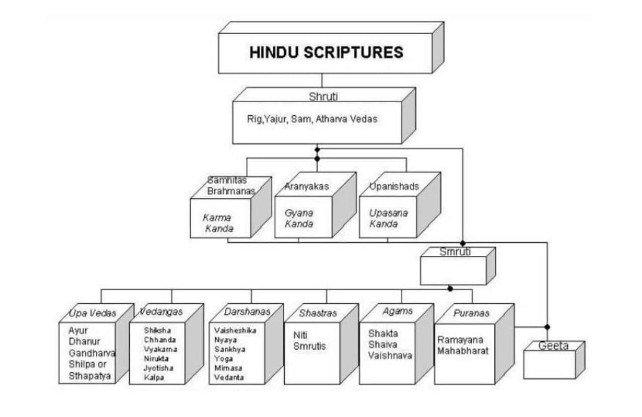
Literature
Vedas the earliest known literature in India.
The Vedas were written in Sanskrit.
The period of the modern Indian literature starts with the first movements for independence in the mid-19th century.
Emergence of literary prose in all the modern Indian language.
Advent of Printing Press Patronage : Englishman, William Carey Serampore, Bengal.

Slide 11
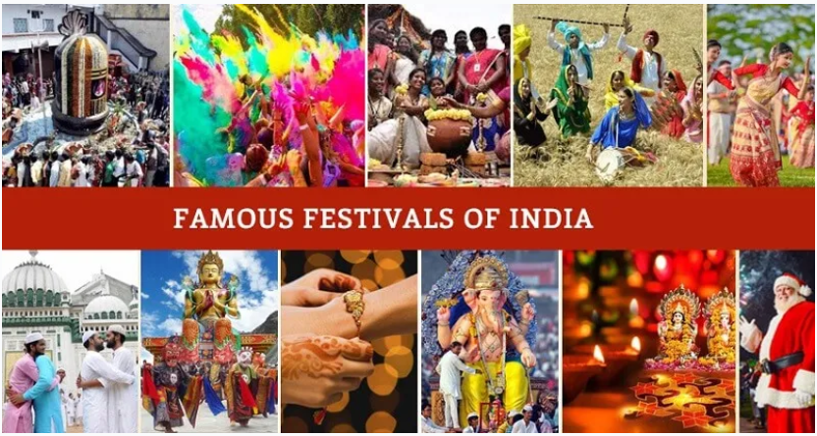
Religions & Festivals
Religions
India is characterized mainly by 4 religions i.e. Hinduism, Sikhism, Muslim, and Christians. Each and every religion has its own rituals and traditions. The dressing styles of these religions are different from one another. The ladies of Hindu religion wear sarees. Today there is a trend of Indian sarees online.
Festivals
India being a land of dissimilar religions, various festivals is famous throughout the nation. Some of these festivals are Diwali, Holi, Christmas, Easter, and Pongal. Tourists usually visit India during the festive season to be a part of the colourful festivities that are a part and package of each and every festival in the nation.

Slide 12
Thank You

